Slide 1
M3

Slide 2

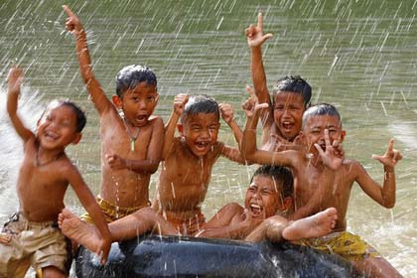

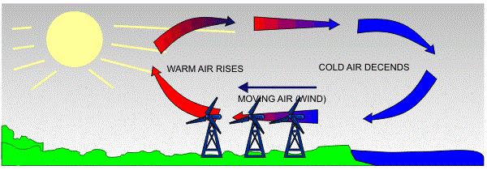
The movement of air : winds
We have all felt the relief brought by cool evening breezes after a hot day.
Sometimes, we are lucky enough to get rains after some days of really hot weather.
What causes the movement of air, and what decides whether this movement will be in the form of a gentle breeze, a strong wind or a terrible storm?
All these phenomena are the result of changes that take place in our atmosphere due to the heating of air and the formation of water vapour.
The atmosphere can be heated from below by the radiation that is
reflected back or re-radiated by the land or water bodies.

Slide 3
The movement of air : winds
On being heated, convection currents are set up in the air.
Warm air raises up and cool air takes its place.
Thus, the movement of air from one region to other creates winds.

Slide 4






High pressure
Low pressure
Sea breeze
Since soil gets heated faster than water, the air above land gets heated faster than the air above water.
During day, heated air above the land starts rising creating a low pressure area.
This causes air to move from high pressure area over the sea to low pressure area over the sea.
This creates sea breeze.

Slide 5

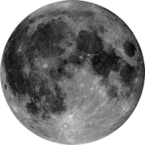
Low pressure
High pressure
Land breeze
At night, since soil cools faster than water, the air above the land is cooler than air above the air
This cause air to move from high pressure area over the land to low pressure area over the sea.
This creates land breeze.

